Slide 1
Global Office 365 Bootcamp – København, Danmark
Anders Dissing
Microsoft Office Servers and Services MVP, Formand for SPBG

Slide 2
Agenda
Time | Topic / Activity | Speaker
9:00 | Velkomst | Anders
9:15 | Microsoft Adaptive Cards ink hands-on labs | Anders
11:00 | Pause
11:15 | Office Add-ins (Word) | Anders
12:00 | Frokost
12:45 | Office Add-ins (Word/Excel) ink hans-on labs | Anders
14:00 | Pause med Survey og SWAG
14:30 | Microsoft Graph / SharePoint Framework | Per
16:14 | Afslutning

Slide 3
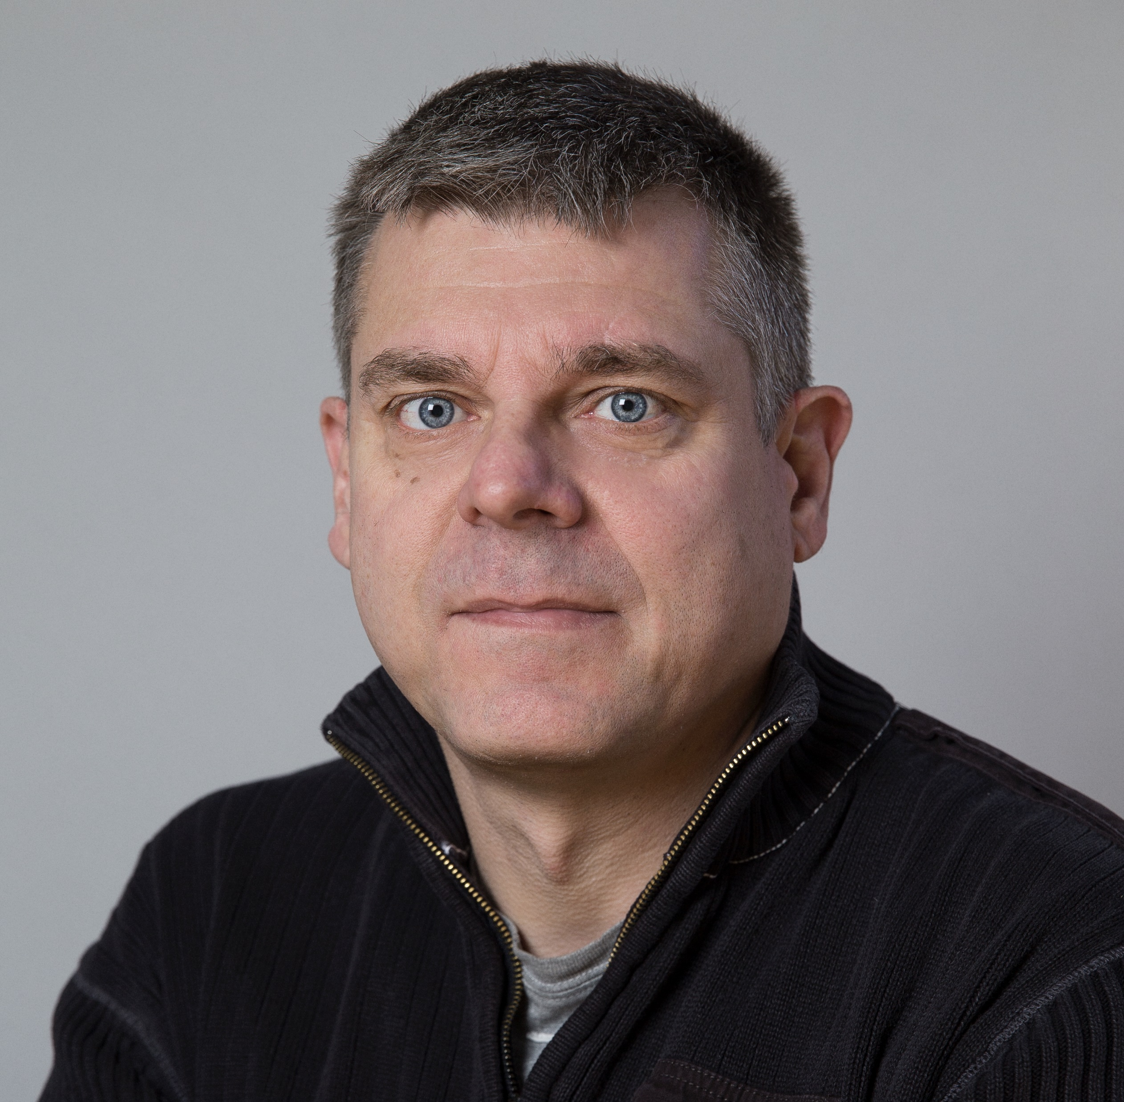
Speaker introduction - Per
Per Jakobsen – Principal SharePoint Developer https://www.linkedin.com/in/pjakobse, @SingingKnight
Per has been programming professionally for more than 35 years. He has programmed for:
mainframes in COBOL and ADABAS
PCs in Pascal, C++, Paradox and dBASE
Client/server in Paradox and PowerBuilder
Nokia phones in ANSI C
But have focused on SharePoint (C# and TypeScript) since 2007.

Slide 4
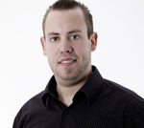
Speaker introduction - Anders
Anders Dissing – MVP and SPBG chairman https://www.linkedin.com/in/andersdissing, @andersdissing
Anders is a SharePoint architect and lead developer. He has worked extensively with SharePoint (2013/2010/2007/2003) from different angles such as development, architecture, consulting, management and upgrading.
Back in 2011, Anders was awarded with his first Microsoft MVP title.
In 2008, Anders established the Danish SharePoint user group. Since then, he has organized many user group events, one SharePoint Saturdays and has participated as a speaker in many of these events.

Slide 5
Telefon, kaffe og wc

Slide 6
Andre møder
SPBG stiftende generalforsamling af brugergruppen og ERFA møde nyt fra Ignite
SPBG Office 365 Dev Camp 2018

Slide 7
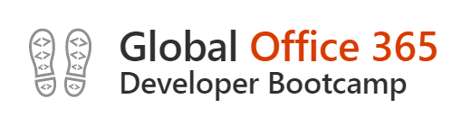
Wifi: Connection Instructions
• Make sure your wireless adapter is set to dynamically obtain an IP address • Connect to the wireless network MSFTGUEST • Open a browser and navigate to a web site to be redirected to the Captive Portal • Click on Event Attendee Code and enter the access code: msevent44ys

Slide 8
Download hands-on labs: https://github.com/andersdissing/OfficeBootcamp-2018-10-23

Slide 9
2018 Global Office 365 Developer Bootcamp Feedback http://bitly.com/2AhlOke

Slide 10

Enjoy the Bootcamp

